Slide 1
Kellogg’s
Strength | Weakness | Opportunity | Threats
The Breakfast Club - Group 03
Yasuhiro Arai Brin Harper
Katya Bondareva Harry Kaushal
Rajvir Grewal Riley Layton
Notes:
Good Morning Ladies and Gentlemen! We are The Breakfast Club, the group number 3, representing our firm Kellogg’s. And today we’re going to present the SWOT analysis for the same.

Slide 2
Index
Our Team of Professionals
Firm’s Introduction
SWOT Analysis
Conclusion
Notes:
First of all, we have introduction to our team of professionals, then we are going to present the overview of Kellogg’s, followed by a SWOT analysis and a definitive conclusion.

Slide 3




The Team
Yasuhiro Arai Haskayne School of Business
“License to Business”
Brin Harper Haskayne School of Business
“Keep Calm and Business On”
Harry Kaushal Haskayne School of Business
“Surviving on Coffee”
Katya Bondareva Haskayne School of Business
“Used to be in finance but lost interest”
Riley Layton Haskayne School of Business
“I’m barely awake right now”
Rajvir Grewal Haskayne School of Business
Notes:
Here, This is our team. Due to collective efforts of everyone, we are standing in front of you and presenting this presentation.

Slide 4
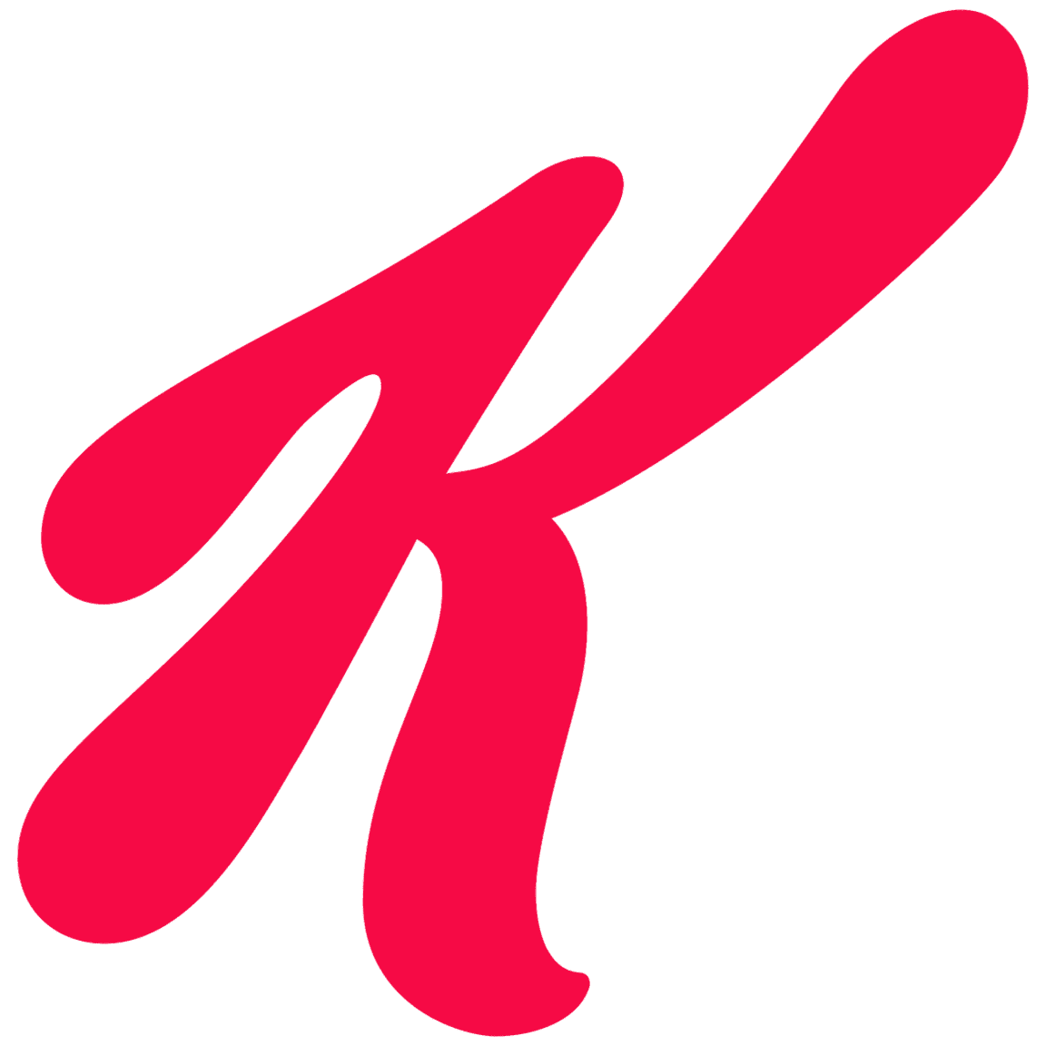
Kellogg’s!
Introduction
Formally known as the Kellogg Company
Founded by W.K. Kellogg
Originated in the year 1906
Specialization in Food Processing Industry…
Notes:
Kellogg’s, as we all know by the name, is formally known as The Kellogg Company, which was founded by Will Keith Kellogg in the year 1906. It’s a globally recognized brand specializing in the food processing Industry for more than a decade now.

Slide 5


Strengths & Weaknesses
Diverse Portfolio
Global Presence
Marketing and Advertising
Dependence on Cereal Market
Quality Concerns
High Operating Costs
Notes:
Kellogg has many strengths one of which is a wide portfolio. This ensures that even if one product of the company failed or was no longer in demand, there any many other product lines that are able to keep company sales high. Also, Kellogg’s has offices all around the world and sells their products in a lot of countries globally. This gives them a larger market to which they can sell their products and this helps to significantly increase their revenue and profits. It also allows for many different ideas from different parts of the world to be collected and discussed which leads to the best possible product. Another strength of Kellogg’s is their efficient and effective use of marketing and advertising around the world which has resulted in the company being well known and famous in several different countries.
Some weaknesses include a dependence on the cereal market, some quality concerns with products and the high operating costs that the company has.

Slide 6


Opportunities & Threats
E Commerce
Influencers
Cost-Of-Living Crisis Drives m Innovation
Getting Sued
Increasing Competition
Healthy Living Trends
Notes:
Kellogg has a range of opportunities to enhance and improve the profit margins by perfecting there e-commerce platform, finding influencers to advertise the company and changing some of the weaknesses to strengths.
Some threats that the company faces are getting sued, increasing competition and overall healthy living trends that are making some of the products less popular because of the unhealthy aspect of the products such as some cereals having lots of sugar added.

Slide 7
Conclusion
Kellogg’s, a global cereal leader, is a strong brand but faces stiff competition which is one of the major threats. Kellogg can use their strengths of marketing and advertising, diverse portfolio and a global presence to help get an advantage over their competitors. Kellogg does have a few weaknesses such as quality concerns and high operating costs which they need to work on how to eliminate as doing so would be very beneficial. Finally, they should consider their available opportunities in health snacks and distribution expansion are promising, but should be careful of regulations.
Notes:
Kellogg’s, a global cereal leader, is a strong brand but faces stiff competition which is one of the major threats. Kellogg can use their strengths of marketing and advertising, diverse portfolio and a global presence to help get an advantage over their competitors. Kellogg does have a few weaknesses such as quality concerns and high operating costs which they need to work on how to eliminate as doing so would be very beneficial. Finally, they should consider their available opportunities in health snacks and distribution expansion are promising, but should be careful of regulations.

Slide 8
References
Britannica (2023, September 7). Kellogg’s: American company.
https://www.britannica.com/topic/Kellogg-Company
Bureau van Dijk. (n.d.). Kellogg Company.: Industry & activities Kellogg Company. Orbis. Retrieved October 12, 2023, from https://www.orbis.bvdinfo.com Choi, B. (2015, February 13). Changing consumer tastes impacts Kellogs. The food institute. https://foodinstitute.com/focus/kelloggfeb2015 Craft Co. (2023, October). Company summary: Overview. https://craft.co/kellogg/ Feldkamp, B. (2023, October 2). More than a cereal king: W.K. Kellogg was a conservationist who helped save the Canada goose The Express. https://www.lockhaven.com/opinion/columns/2023/10/more-than-a-cereal-king-w-k-kellogg-wa s-a-conservationist-who-helped-save-the-canada-goose/ Joseph, S. (2019, June 20). Inside Kellogg’s social-driven strategy to launch new products. Digiday. https://digiday.com/media/inside-kelloggs-social-driven-strategy-to-launch-new-products/
WorldBenchmarkingAlliance (n.d.). Kellogg’s. Retrieved November 26, 2023, from https://www.worldbenchmarkingalliance.org/publication/food-agriculture/companies/kelloggs-2/#:~:text=Some%20of%20the%20most%20well,products%20in%20over%20180%20countries.

Slide 9

Thank You
Pleasure doing business with you!

